Slide 1
History of the World Wide Web
Technologies
Masanori Kawai 22nd/Sep/2010

Slide 2
Content
Early history of World Wide Web
Apache Http Server/CGI
Java Web Application Server

Slide 3
Early history of World Wide Web

Slide 4
History of the World Wide Web
Late 1970s – early 1980s
  Development of Ether network.
  Development of TCP/IP(version4)
Berners-Lee(British Physics Scientist)
  He wrote a proposal in March 1989 for "a large hypertext database with typed links“
  His boss, Mike Sendall, encouraged Berners-Lee to begin implementing his system on a newly acquired NeXT workstation(later MacOS X).

Slide 5
History of the World Wide Web
By Christmas 1990, Berners-Lee had built all the tools necessary for a working Web
  the HyperText Transfer Protocol (HTTP) 0.9
  the HyperText Markup Language (HTML)
  the first Web browser (named WorldWideWeb)
  the first HTTP server software (later known as CERN httpd)

Slide 6
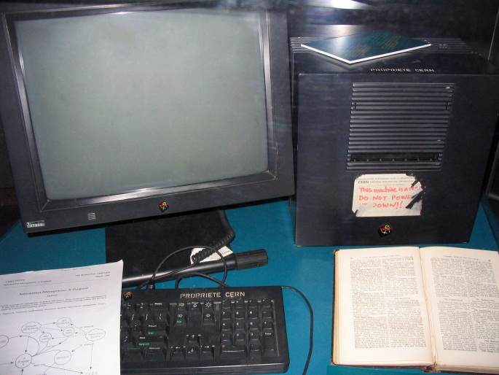
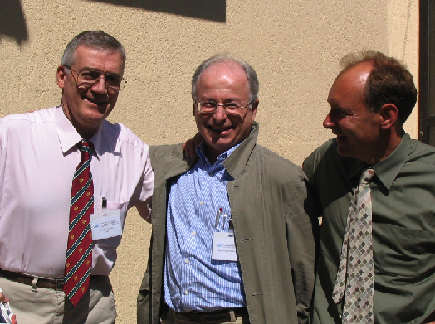
History of the World Wide Web3
British Physics Scientist
Berners-Lee

Slide 7



“Server-client” + “Hyper Link” e.g. Customer Information
http://ABC.com/customer.html
http://XYZ.com/customer.html
http://123.com/customer.html

Slide 8
“Server-client” + “Hyper Link” e.g. Customer Information
http://ABC.com/customer.html
http://XYZ.com/customer.html
http://XYZ.com/customer.html
http://123.com/customer.html

Slide 9
“Server-client” + “Hyper Link” e.g. Customer Information
http://ABC.com/customer.html
http://XYZ.com/customer.html
http://XYZ.com/customer.html
http://123.com/customer.html

Slide 10
“Server-client” + “Hyper Link” e.g. Customer Information
http://ABC.com/customer.html
http://XYZ.com/customer.html
http://XYZ.com/customer.html
http://ABC.com/customer.html
http://123.com/customer.html
http://123.com/customer.html

Slide 11
“Server-client” + “Hyper Link” e.g. Customer Information
http://ABC.com/customer.html
http://XYZ.com/customer.html
http://XYZ.com/customer.html
http://ABC.com/customer.html
http://123.com/customer.html
http://123.com/customer.html

Slide 12
“Server-client” + “Hyper Link” e.g. Customer Information
http://ABC.com/customer.html
http://XYZ.com/customer.html
http://XYZ.com/customer.html
http://ABC.com/customer.html
http://123.com/customer.html
http://123.com/customer.html

Slide 13
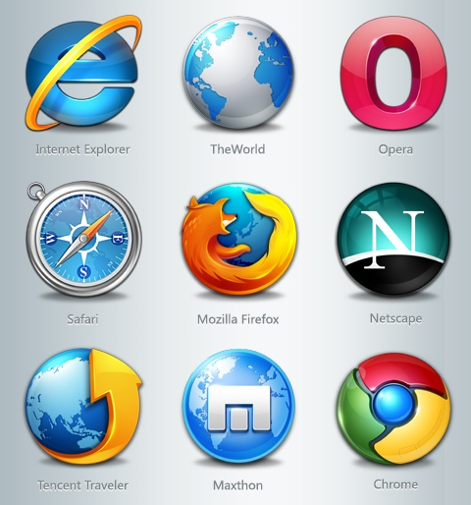
Client Side
(Web Browser)
Mosaic
Netscape Communicator
Internet Explorer
Firefox, Safari, Chrome etc…

Slide 14
Apache Http Server

Slide 15
Apache Http Server/CGI
Most famous HTTP(Web) Server
  Basic feature is to return HTML files from client request.
  50% coverage on Internet WWW sites
CGI (Common Gateway Interface)/ RFC 3875
  The http servers invoke the script engine(asp, php, perl, and so on) as a command.
  The scripts output the html text through standard output.

Slide 16
Old Apache Http Server/CGI
<HTML>
<BODY>
<H1>Hello World</H1>
</BODY>
</HTML>
index.html
index.html
<HTML>
<BODY>
<H1>Hello World</H1>
</BODY>
</HTML>
open
read
POST or GET
HTML files

Slide 17
Old Apache Http Server/CGI
#!/usr/bin/perl
print "Content-type: text/html\n\n";
print <<"EOF";
<HTML>
<BODY>
print localtime();
</BODY>
</HTML>
EOF
NOT HTML file
This is SCRIPT FILE
time.cgi
time.cgi
<HTML>
<BODY>
Mon, 15 Aug 05
</BODY>
</HTML>
invoke
output
POST or GET
HTML files

Slide 18
Old Apache Http Server/CGI
#!/usr/bin/perl
print "Content-type: text/html\n\n";
print <<"EOF";
<HTML>
<BODY>
print localtime();
</BODY>
</HTML>
EOF
<HTML>
<BODY>
<H1>Hello World</H1>
</BODY>
</HTML>
index.html
time.cgi
invoke
open
output
read
POST or GET
HTML files

Slide 19
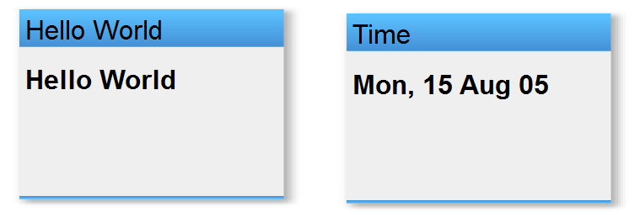
Browser Output
index.html
time.cgi

Slide 20
Current Apache Http Server/CGI
<html>
<body>
Hello World
<?php print date(DATE_RFC822); ?>
</body>
</html>
To replace output
from PHP script
index.php
<html>
<body>
Hello World
Mon, 15 Aug 05
</body>
</html>
read
open
POST or GET
HTML files

Slide 21
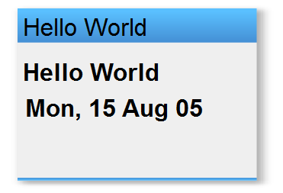
Browser Output
index.php

Slide 22
Apache Http Server(PHP) and IIS(ASP)
Most of non-mission critical web sites use Apache Server + MySQL + PHP
  Wikipedia
  Many news sites
  Local store’s reservation and commerce site.
PHP5 introduced object-oriented function
  Of course, this is script language, but we can compile it to intermediate machine language.
Java is not free in Commercial usage.

Slide 23
IIS/ASP(Active Server Page) in eProject1
<form method="post" action="phonelist.asp" target="mainpage">
<select name="Brand" id="Brand">
<% while (!PhoneRecord.EOF) { %>
<option value="<%=(PhoneRecord.Fields.Item("Brand").Value)%>">
<%=(PhoneRecord.Fields.Item("Brand").Value)%>
</option>
<% PhoneRecord.MoveNext();
}
if (PhoneRecord.CursorType > 0) {
if (!PhoneRecord.BOF) PhoneRecord.MoveFirst();
} else {
PhoneRecord.Requery();
}%>
</select>
<input type="submit" name="submit" value="Go"/>
</form>
Processing Tag

Slide 24
Output html text
<form method="post" action="phonelist.asp" target="mainpage">
<select name="Brand" id="Brand">
<option value="Apple">Apple</option>
<option value="BlackBerry">BlackBerry</option>
<option value="LG">LG</option>
</select>
</form>

Slide 25
Java Web Application Server

Slide 26
Sun JavaWebServer(J2EE1.2) 1997
A new type of Web Server with Java Technology
  Servlet 2.3 (JSR-53) 1998
    Nowadays, these servers are referred as WebContainer or Application Server.
Other vendor product
  IBM WebSphere Application Server
  Apache Jakarta Project(now Apache Tomcat)
  Sun Glassfish
  ….etc (NEC, Hitachi, Fujitus have their own application servers)

Slide 27

Sun JavaWebServer(J2EE1.2)
index.class
time.class
execute
execute
output
output
JavaVM
GET or POST
Output of html file
Web Server
Client

Slide 28
However....
It is useful to use Servlet(Java Program) instead of CGI for programmer.
  To support XML API, Security API, Portability and so on.
Programming is difficult for Web Designer.
Web application should have html output as view side(in model-control-view)

Slide 29
JSP(Java Server Page)
Sun Microsystems inspired from the processing tag specifications from ASP.
In that time, ASP was famous and widely was used in IIS server.
JSPs have the same HTML(ASP) structure.
  However, Web Server should compile JSPs files to class files with JSP Compiler.
  One of the famous JSPs compiler is jasper2 (within Apache Tomcat and Sun Glassfish)

Slide 30
JSP(Java Server Page)
<HTML>
<BODY>
Hello World
</BODY>
<HTML>
JSP
index.jsp
JSP compiler(jasper2)
public class Index_jsp extends HttpServlet {
…….
out.write(“<HTML>”);
out.write(“<BODY>”);
out.write(“Hello World”);
out.write(“</BODY>”);
out.write(“</HTML>”);
……}
Java source
index_jsp.java
Java compiler(javac)
Java class
00010100101…..
index_jsp.class

Slide 31
Forward/Redirect
I show the difference between Forward and Redirect.
In forward, client(Web Browser) can not detect accessing the different pages.
In redirect, server requests client to access the different pages.
  For example………

Slide 32
Thank you for your attention.

